Slide 1
PRIVATE & CONFIDENTIAL
A Golden Investment Opportunity
(Under the framework of IBC, 2016)
CIRP commenced pursuant to order of the Hon’ble NCLT, Allahabad Bench dated 14th July, 2026.
SVP INDUSTRIES LIMITED
(Distillery & Ethanol Unit)
Bhoopesh Gupta
Resolution Professional
Regn. No. IBBI/IPA-001/IP-P01468/2018-2019/12271
Website: www.cirpsvp.in
Email id: Svpind.cirp@gmail.com

Slide 2
Company Profile
BOARD OF DIRECTORS
COMPANY INFORMATION
SVP INDUSTRIES LIMITED
CIN: U21011UP1961PLC002861
Date of Incorporation: 24th October, 1961
Registered Office:
Mansurpur, Muzaffarnagar,
Uttar Pradesh – 251203
1. Govind Swarup
2. Prabhat Kumar Swarup
3. Harsaran Gupta
4. Rahul Swarup
5. Adarsh Kumar Swarup
Existing Business
Manufacture of Alcohol, Country Liquor, IMFL, Ethanol and CO₂.
Annual Installed / Licensed Capacity
875 Lacs BL.
Operating Status
The flyer states that there has been no operation since September 2024.

Slide 3
Company Overview
Asset Profile & Legal Architecture
Historic Identity: SVP Industries Limited (Incorporated in 1961) hosts the iconic "Sir Shadilal Distillery & Chemical Works“ an infrastructure asset.
Approximately 80 acres (3,23,749 sq. mtr.), including core and non-core land.
Operational Infrastructure Capacity
Heavy Production Base: Completely engineered for an active, high-volume capacity of Molasses: 140 KLPD (Kilo Liters Per Day) throughput and a grain plant (100 KLPD) & an ethanol plant (100 KLPD)
16 bottling lines forming part of the core plant infrastructure.
Product Versatility Framework: Purpose-built layout to run Fuel Ethanol, ENA, Rectified Spirits, Country Liquor, and Premium IMFL lines.

Slide 4
Industry Overview & Future Outlook
The Macro Environment
• Massive Market Scale: The Indian liquor and distillery bottling sector is rapidly expanding from USD 15.2 Billion towards USD 23.9 Billion.
• The Biofuel Revolution: Fuel-grade ethanol demand enjoys a stellar 7.2% CAGR, changing traditional distilleries into critical national energy units.
Future Macro Vectors
• Aggressive National Goals: India's National Policy on Biofuels advanced its clean strategy to hit 27% ethanol blending in petrol by 2030.
• Guaranteed Off-Take Contracts: State Oil Marketing Companies (OMCs) sign multi-year pricing structures to secure supply and cover production deficits.
• Premiumisation Margin Boom: Rapid consumer shift toward high-value craft spirits and contract packaging yields immense structural returns.
SVP INDUSTRIES LIMITED | PRIVATE & CONFIDENTIAL

Slide 5
State Growth & Location Advantage
The Biofuel Epicenter: Uttar Pradesh
• Pro-Business Framework: UP State Excise policies offer fast-track single-window clearances and relaxed interstate export frameworks.
• Huge Regional Landscape: The North Indian regional alcohol network is valued at USD 4.4 Billion and rising steadily to USD 6.7 Billion.
Mansurpur, Muzaffarnagar
• The Core Sugar Belt Advantage: Placed at the very heart of heavy sugar milling zones, enabling zero-distance pipeline sourcing for cheap molasses feedstock.
• Grain Sourcing Access: Exceptional transit logistics provide rapid access to grain storage pools in adjoining farming states.
• Minimised Inbound Costs: Strategic placement eliminates multi-state freight taxes and heavily trims material handling overheads.
Connectivity
Located on the Delhi–Muzaffarnagar Highway.
SVP INDUSTRIES LIMITED | PRIVATE & CONFIDENTIAL

Slide 6
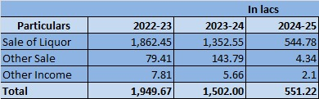
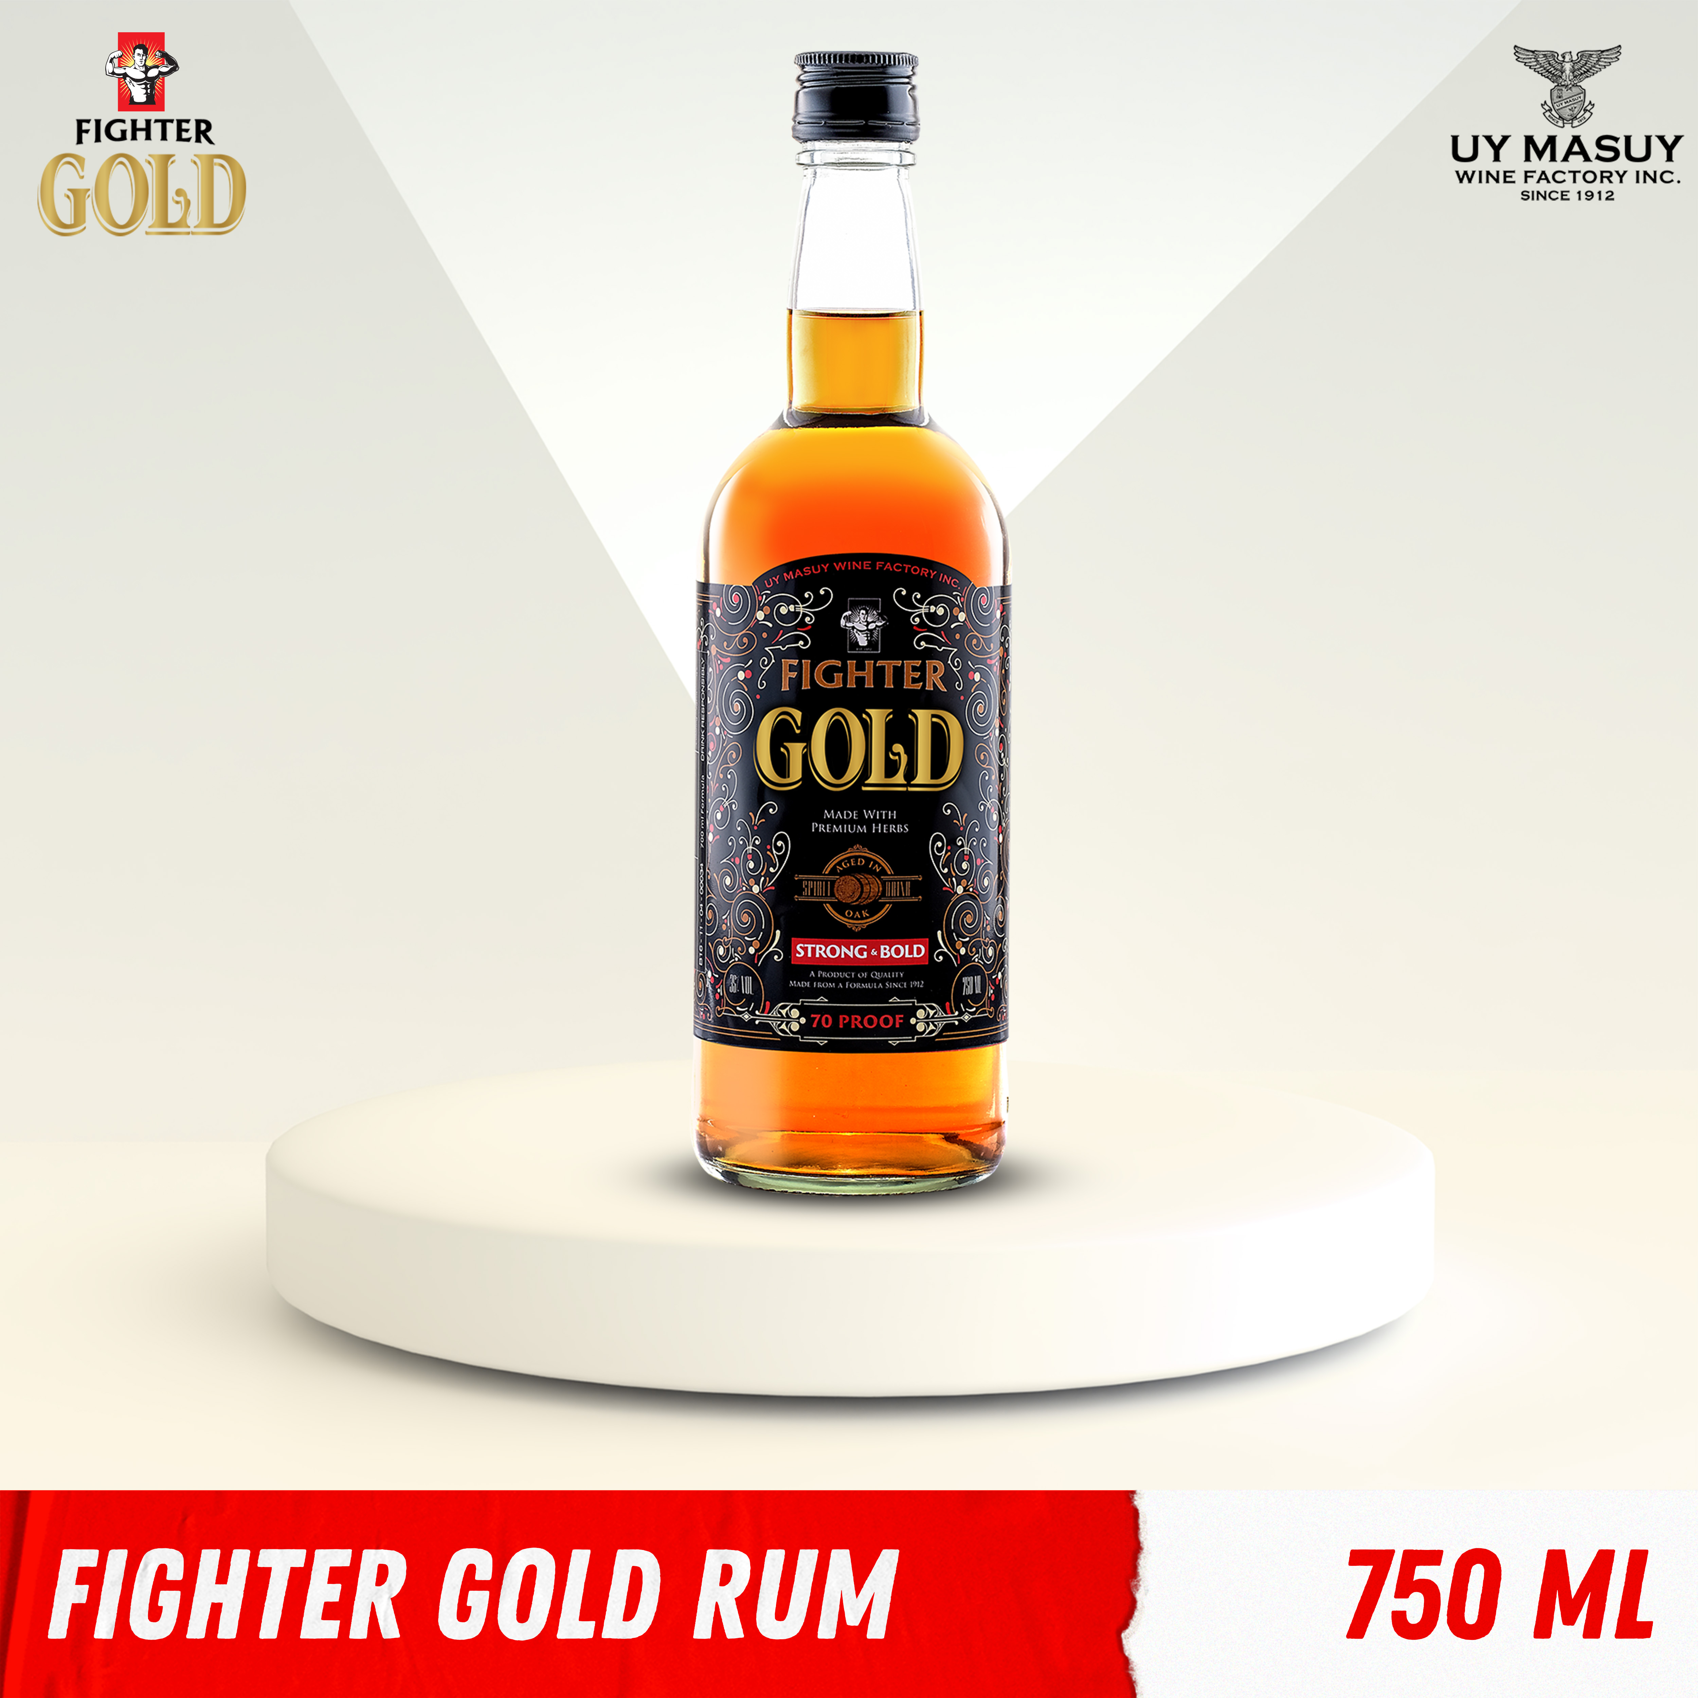
Business Snapshot
Popular Brand
The Company established the following brands:
Fighter Gold
Tohfa
Dil se
Mr. India
Boby Lite

Slide 7
Invitation for Expression of Interest
PUBLICATION OF FORM G
Publication: Jansatta (Hindi) & Financial Express (English)
PUBLICATION DATE
EOI LAST DATE
RESOLUTION PLAN LAST DATE
12.09.2026
03.10.2026
02.12.2026

Slide 8
For Further Information
RESOLUTION PROFESSIONAL
Mr. Bhoopesh Gupta
Regn. No. IBBI/IPA-001/IP-P01468/2018-2019/12271
Contact: 9643161757 (CS SURAJ)
svpind.cirp@gmail.com
www.cirpsvp.in
DISCLAIMER: The information contained/disclosed in this Flyer is as provided by the Corporate Debtor, information available in the public domain. No representation or warranty, express or implied, is given by the Corporate Debtor, any of its Officers, Employees or Agents, or the Resolution Professional or his team or CoC as to the accuracy, authenticity or completeness of the contents of this Flyer or any other document or information supplied, or which may be supplied at any time, or any opinions or projections expressed herein or therein. No such party is under any obligation to update the Flyer or correct any inaccuracies or omissions which may exist or become apparent.
C/o. AVM Resolution Professionals LLP
3rd Floor, 8/28, WEA, Abdul Aziz Road, Karol Bagh, New Delhi – 110005
Phone: 011-41486026/27

